Slide 1

Building Lovable.dev: Our Journey Creating a
E-Commerce Website with Free AI Tools

Slide 2

Meet the Creators
G.V.L.N. Dumbu & J. Vasanth Kumar
Passionate about leveraging AI and no-code platforms
Our Goal
Build a genuine, user-friendly product review site quickly and affordably

Slide 3


Why a Product E-Commerce?
Consumer Trust
Consumers crave trustworthy, unbiased reviews in a crowded market.
Market Opportunity
An opportunity to fill gaps with authentic, AI-assisted content and unique perspectives.
Empowering Decisions
Our vision is to help users make informed buying decisions through comprehensive insights.

Slide 4
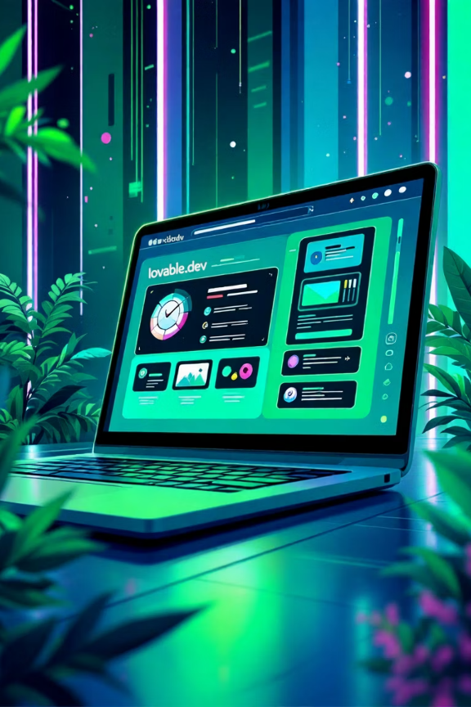
Choosing Our Platform: Why Lovable.dev?
Lovable.dev
An open-source ERP with a powerful, integrated website builder.
No-Code Simplicity
Features a drag-and-drop interface, making website creation accessible without coding.
Integrated Ecosystem
Seamlessly integrates apps for SEO, blogging, and eCommerce functionalities.
Scalability
Offers a free trial and is designed to be scalable for future business expansion.

Slide 5

Step 1: Setting Up Our Website on Lovable.dev
Registration & Trial
Registered at Lovable.dev and initiated our free trial, gaining access to the platform's features.
Website Builder Selection
Chose the intuitive Website Builder app for an effortless and efficient design process.
Layout Customization
Tailored the website layout to prominently display product categories and review sections.
Community Integration
Integrated blog and forum features to foster a vibrant and engaged user community.

Slide 6





Step 2: Leveraging Free AI Tools for Content Creation
AI Writing
Utilized AI writing assistants to generate initial review drafts, saving valuable time.
AI Visuals
Employed AI image generators to create compelling and relevant product visuals.
AI SEO
Automated SEO optimization with AI-powered tools to enhance search engine visibility.
Human Touch
Ensured all AI-generated content underwent rigorous human editing for authenticity and accuracy.

Slide 7




Step 3: Organizing Reviews & User Experience
Clear Navigation
User Feedback
Designed intuitive navigation with distinct categories, top-rated sections, and latest reviews.
Integrated user rating and comment features seamlessly through Lovable.dev's application ecosystem.
Fast Performance
Mobile Responsive
Achieved fast loading times through strategic optimization on Lovable.dev’s robust hosting infrastructure.
Ensured a fully mobile-responsive design for optimal accessibility across all devices.

Slide 8

Challenges & Solutions
Challenges Faced
Our Solutions
Achieving balance between AI-generated content and genuine human sentiment.
Implemented a strict human review process for all AI content, ensuring authenticity.
Navigating the learning curve associated with Lovable.dev’s extensive suite of features.
Leveraged Lovable.dev's comprehensive documentation and engaged with its active community forums.
Implementing robust measures to ensure site security and safeguard data privacy.
Utilized Lovable.dev's built-in security features and consistently applied best practices for data protection.

Slide 9

The Result: Genuine-Reviews.lovable.app
Live & Functional
A fully operational website showcasing authentic product reviews, built from scratch.
Engaged Community
Successfully engaged early users with interactive features, fostering a growing community.
Future-Ready Platform
A scalable platform, poised and ready for future integrations with advanced AI technologies.
Visit us: genuine-reviews.lovable.app
Our website name is: SHOPHUB

Slide 10




Thank You!
G.V.L.N. Dumbu & J. Vasanth Kumar
Innovate with Us
Harnessing free AI tools and Lovable to empower consumers and inspire new creators.
We are grateful for your time and interest in our project.
Join Our Journey
We are ready to innovate further and invite you to join us on this exciting journey!

